Slide 1
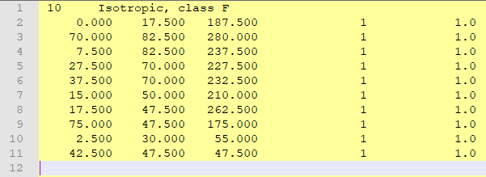
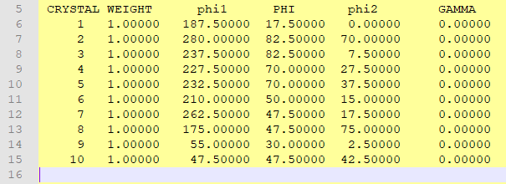
Euler angles in smt and cur formats have different order!
smt
cur
phi2
PHI
phi1
phi1
PHI
phi2

